Slide 1

CHAPTER 5
SEQUENCES,
MATHEMATICAL
INDUCTION, AND
RECURSION
Copyright © Cengage Learning. All rights reserved.

Slide 2
SECTION 5.8
Second-Order Linear Homogeneous
Recurrence Relations with
Constant Coefficients
Copyright © Cengage Learning. All rights reserved.

Slide 3
Second-Order Linear Homogeneous Recurrence Relations with Constant Coefficients
Iteration is a basic technique that does not require any special tools beyond the ability to discern patterns.
In many cases a pattern is not readily discernible and other methods must be used.
A variety of techniques are available for finding explicit formulas for special classes of recursively defined sequences.
The method explained in this section is one that works for the Fibonacci and other similarly defined sequences.

Slide 4
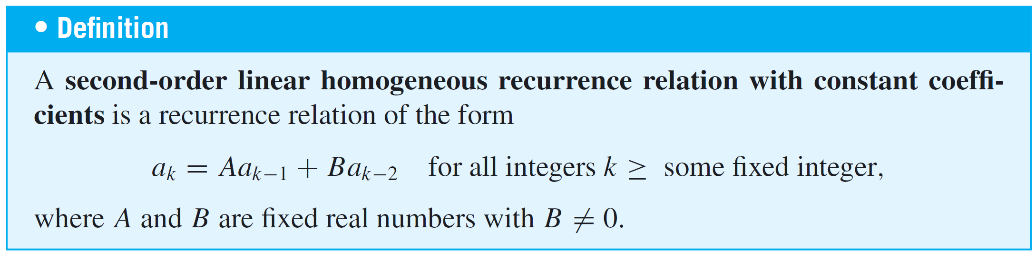
Second-Order Linear Homogeneous Recurrence Relations with Constant Coefficients
“Second-order” refers to the fact that the expression for a_{k} contains the two previous terms a_{k−1} and a_{k−2}, “linear” to the fact that a_{k−1} and a_{k−2} appear in separate terms and to the first power, “homogeneous” to the fact that the total degree of each term is the same (thus there is no constant term), and “constant coefficients” to the fact that A and B are fixed real numbers that do not depend on k.

Slide 5


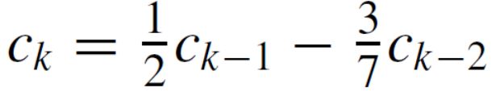




Example 1 – Second-Order Linear Homogeneous Recurrence Relations with Constant Coefficients
State whether each of the following is a second-order linear homogeneous recurrence relation with constant coefficients:
a. b.
c. d.
e. f.
g. h.

Slide 6
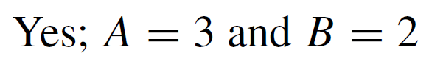

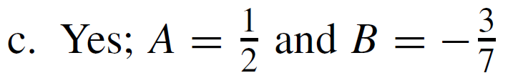

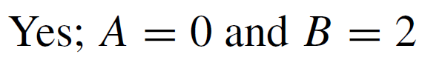


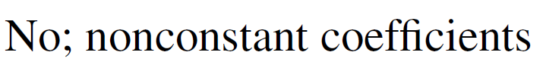
Example 1 – Solution
a.
b.
c.
d.
e.
f.
g.
h.

Slide 7
The Distinct-Roots Case

Slide 8
The Distinct-Roots Case
Consider a second-order linear homogeneous recurrence relation with constant coefficients:
where A and B are fixed real numbers. Relation (5.8.1) is satisfied when all the a_{i} = 0, but it has nonzero solutions as well.

Slide 9
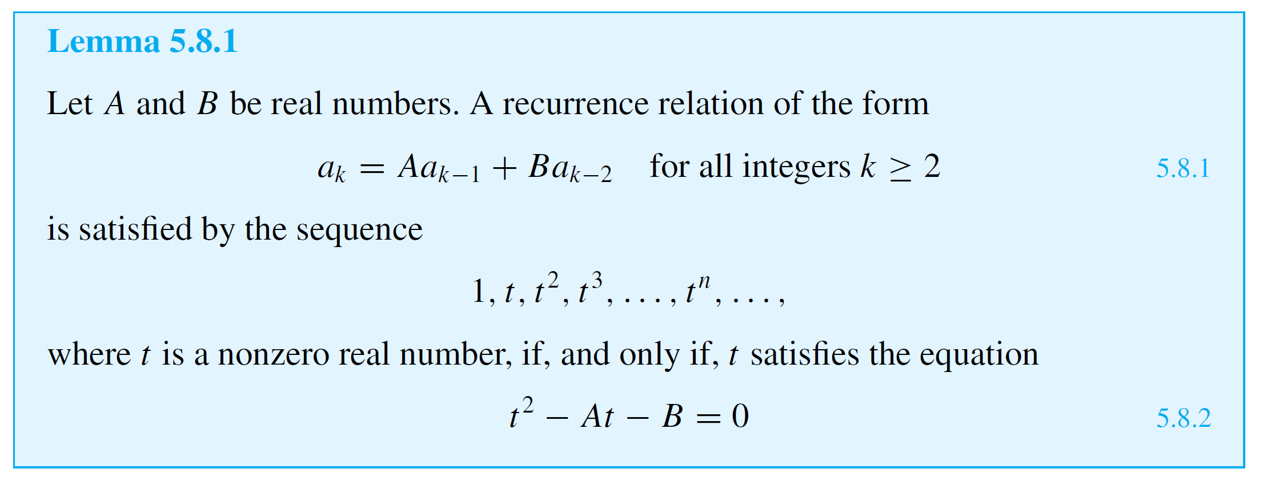
The Distinct-Roots Case
Suppose that for some number t with t ≠ 0, the sequence, 1, t, t ², t ³, . . . , t ^{n}, . . . satisfies relation (5.8.1). Then t satisfies the following characteristic equation.

Slide 10
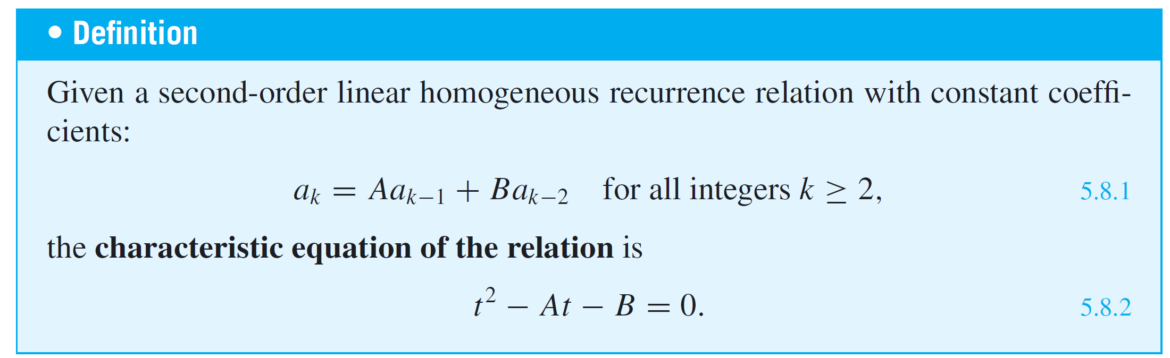
The Distinct-Roots Case
Equation (5.8.2) is called the characteristic equation of the recurrence relation.

Slide 11
Example 2 – Using the Characteristic Equation to Find Solutions to a
Recurrence Relation
Consider the recurrence relation that specifies that the kth term of a sequence equals the sum of the (k – 1)st term plus twice the (k – 2)nd term. That is,
Find all sequences that satisfy relation (5.8.3) and have the form
1, t, t ², t ³, . . . , t ^{n}, . . . ,
where t is nonzero.

Slide 12
Example 2 – Solution
By Lemma 5.8.1, relation (5.8.3) is satisfied by a sequence 1, t, t ², t ³, . . . , t ^{n}, . . . if, and only if, t satisfies the characteristic equation
t ² – t – 2 = 0.
Since
t² – t – 2 = (t – 2)(t + 1),
the only possible values of t are 2 and –1.

Slide 13
Example 2 – Solution
cont’d
It follows that the sequences
1, 2, 2², 2³, . . . , 2^{n}, . . .
and
1, –1, (–1)², (–1)³, . . . , (–1)^{n}, . . . .
are both solutions for relation (5.8.3) and there are no other solutions of this form.
Note that these sequences can be rewritten more simply as
1, 2, 2², 2³, . . . , 2^{n}, . . . and 1, –1, 1, –1, . . . , (–1)^{n}, . . . .

Slide 14
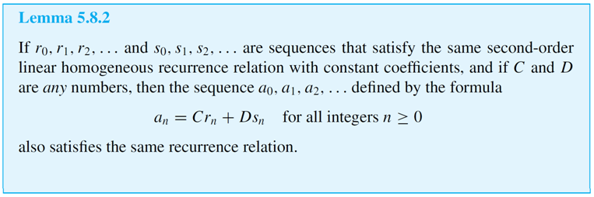
The Distinct-Roots Case
The Example 2 shows how to find two distinct sequences that satisfy a given second-order linear homogeneous recurrence relation with constant coefficients.
It turns out that any linear combination of such sequences produces another sequence that also satisfies the relation.

Slide 15
The Distinct-Roots Case
Given a second-order linear homogeneous recurrence relation with constant coefficients, if the characteristic equation has two distinct roots, then Lemmas 5.8.1 and 5.8.2 can be used together to find a particular sequence that satisfies both the recurrence relation and two specific initial conditions.

Slide 16
Example 3 – Finding the Linear Combination That Satisfies the
Initial Conditions
Find a sequence that satisfies the recurrence relation of Example 2,
and that also satisfies the initial conditions
a₀ = 1 and a₁ = 8.
Solution:
Example 2, the sequences
1, 2, 2², 2³, . . . , 2^{n}, . . . and 1, –1, 1, –1, . . . , (–1)^{n}, . .
both satisfy relation (5.8.3) (though neither satisfies the given initial conditions).

Slide 17
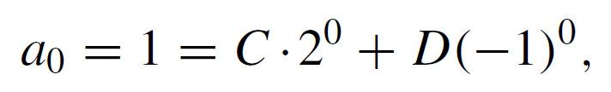

Example 3 – Solution
cont’d
By Lemma 5.8.2, therefore, any sequence a₀, a₁, a₂, . . . that satisfies an explicit formula of the form
where C and D are numbers, also satisfies relation (5.8.3).
You can find C and D so that a₀, a₁, a₂, . . . satisfies the specified initial conditions by substituting n = 0 and n = 1 into equation (5.8.6) and solving for C and D:

Slide 18

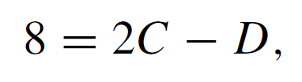



Example 3 – Solution
cont’d
When you simplify, you obtain the system
which can be solved in various ways. For instance, if you add the two equations, you get
and so
Then, by substituting into 1 = C + D, you get

Slide 19
Example 3 – Solution
cont’d
It follows that the sequence a₀, a₁, a₂, . . . given by
for integers n ≥ 0, satisfies both the recurrence relation and the given initial conditions.

Slide 20
The Distinct-Roots Case
The techniques of Examples 2 and 3 can be used to find an explicit formula for any sequence that satisfies a second-order linear homogeneous recurrence relation with constant coefficients for which the characteristic equation has distinct roots, provided that the first two terms of the sequence are known.

Slide 21
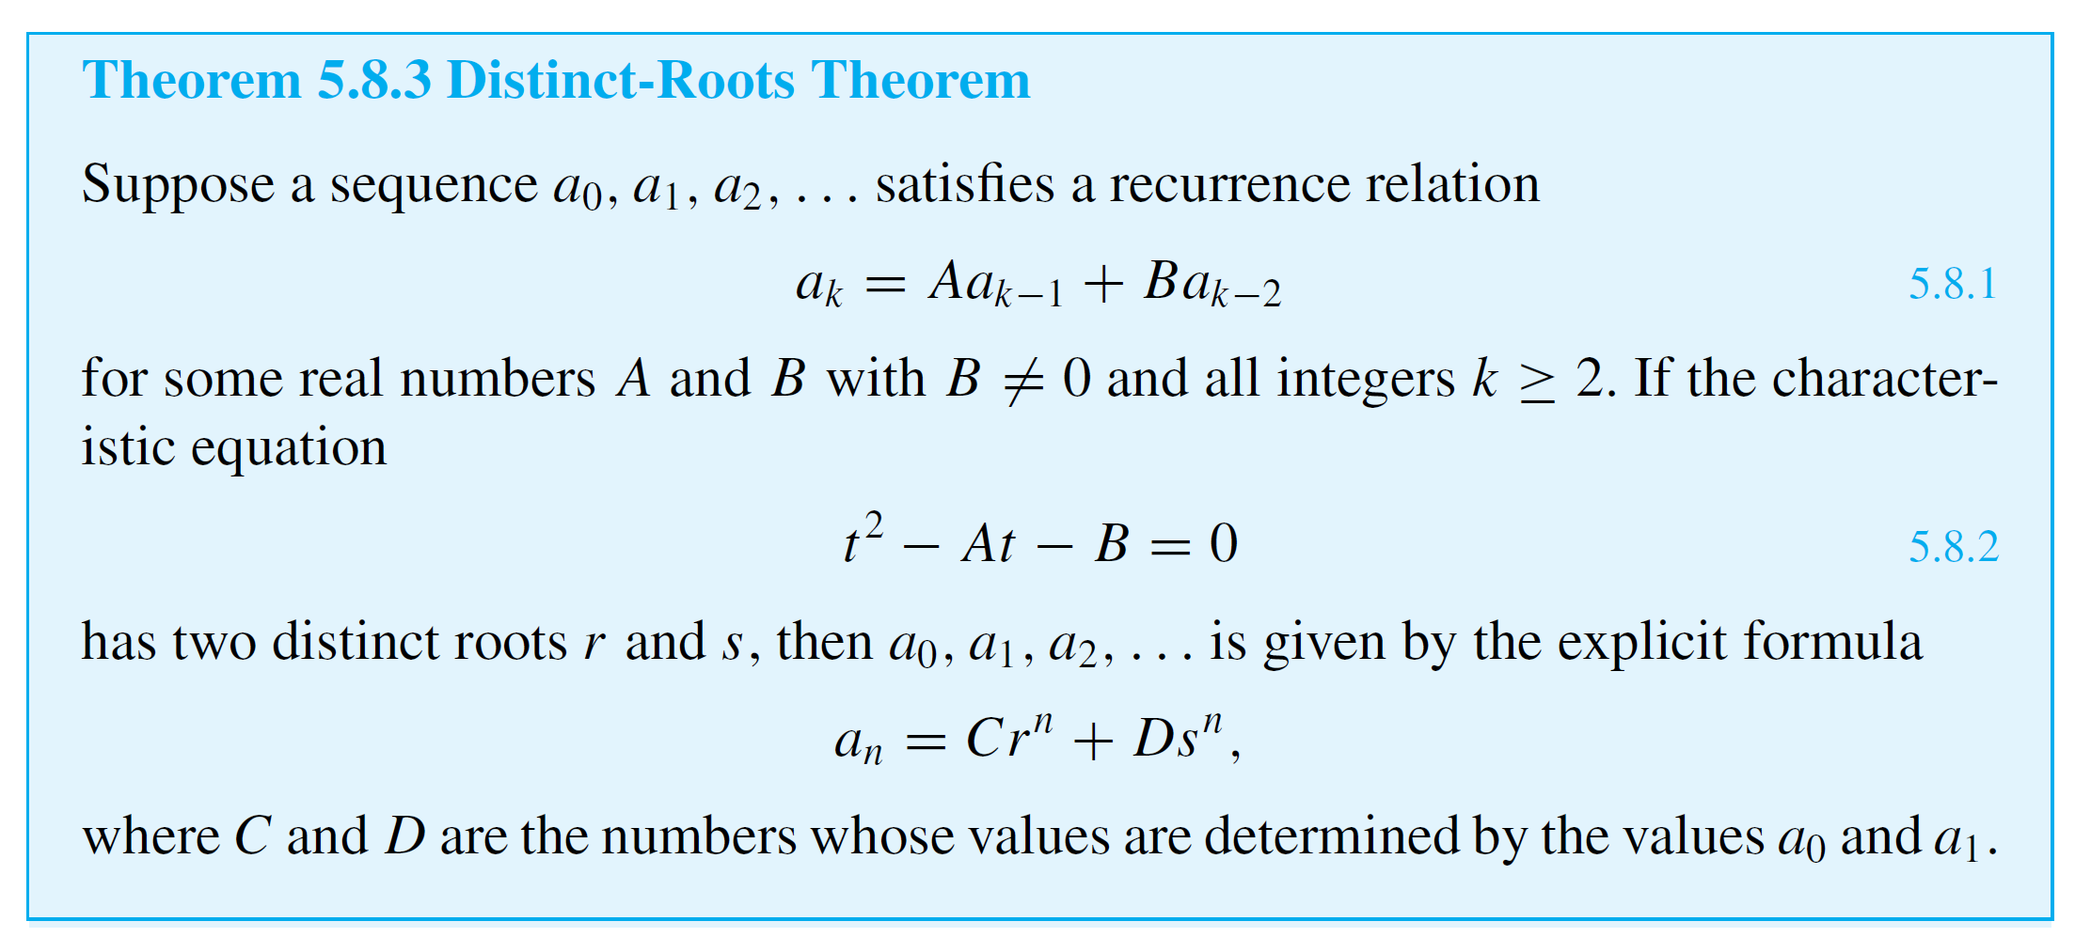
The Distinct-Roots Case
This is made precise in the next theorem.

Slide 22
The Distinct-Roots Case
The next example shows how to use the distinct-roots theorem to find an explicit formula for the Fibonacci sequence.

Slide 23

Example 4 – A Formula for the Fibonacci Sequence
The Fibonacci sequence F₀, F₁, F₂, . . . satisfies the recurrence relation
for all integers k ≥ 2
with initial conditions
F₀ = F₁ = 1.
Find an explicit formula for this sequence.

Slide 24
Example 4 – Solution
The Fibonacci sequence satisfies part of the hypothesis of the distinct-roots theorem since the Fibonacci relation is a second-order linear homogeneous recurrence relation with constant coefficients (A = 1 and B = 1).
Is the second part of the hypothesis also satisfied? Does the characteristic equation
t² – t – 1 = 0
have distinct roots?

Slide 25
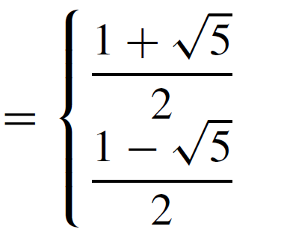
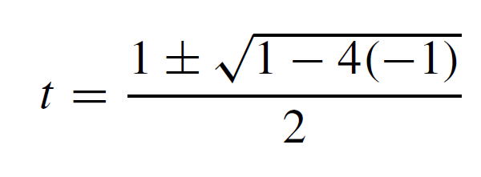
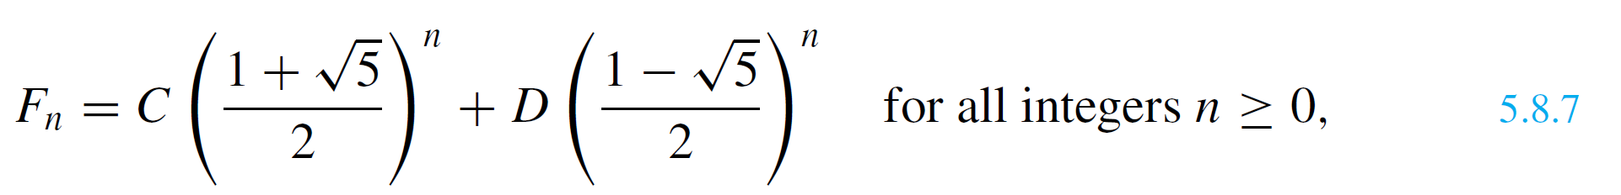
Example 4 – Solution
cont’d
By the quadratic formula, the roots are
and so the answer is yes.
It follows from the distinct-roots theorem that the Fibonacci sequence is given by the explicit formula
where C and D are the numbers whose values are determined by the fact that F₀ = F₁ = 1.

Slide 26
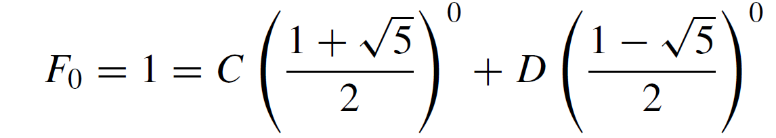
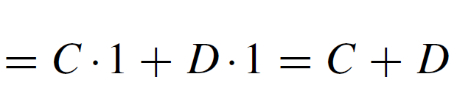
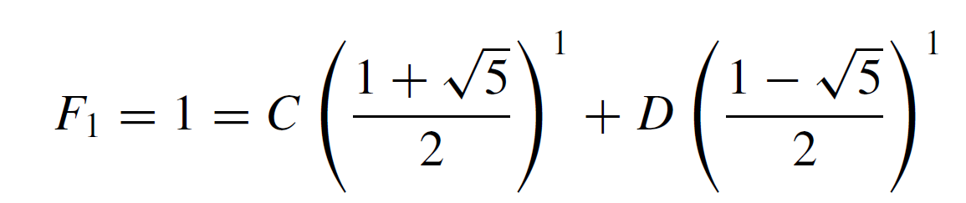
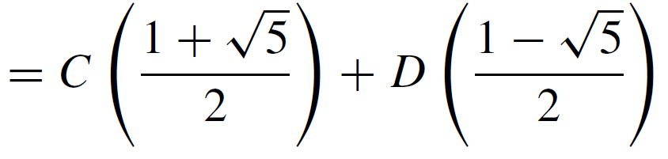
Example 4 – Solution
cont’d
To find C and D, write
and

Slide 27
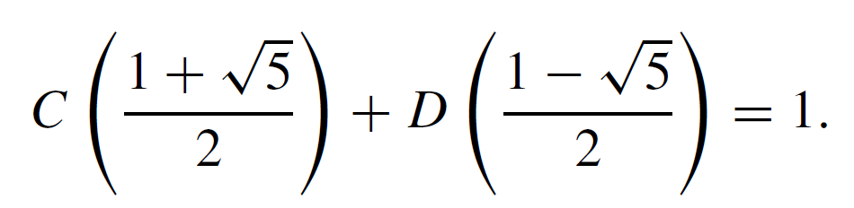
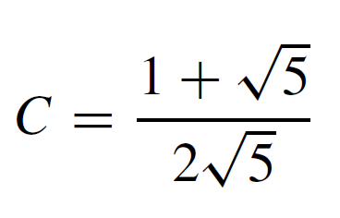
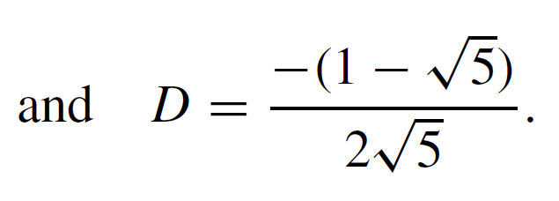
Example 4 – Solution
cont’d
Thus the problem is to find numbers C and D such that
C + D = 1
and
This may look complicated, but in fact it is just a system of two equations in two unknowns.
Solving the system of equations, we have

Slide 28
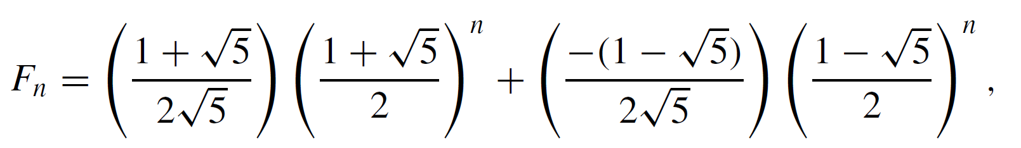
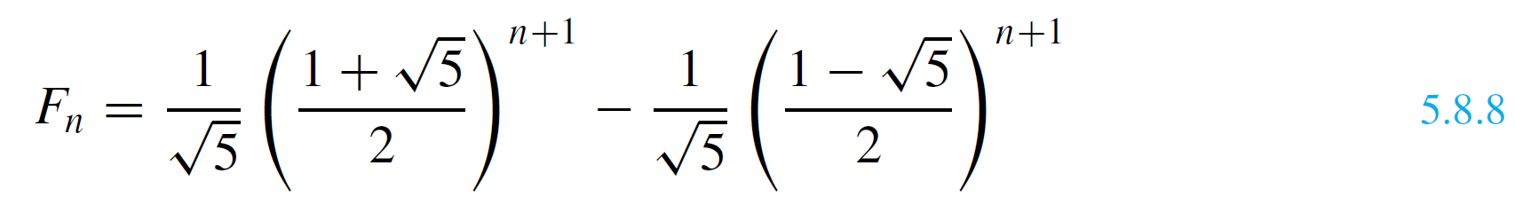

Example 4 – Solution
cont’d
Substituting these values for C and D into formula (5.8.7) gives
or, simplifying,
for all integers n ≥ 0.
Remarkably, even though the formula for F_{n} involves all of the values of the Fibonacci sequence are integers.

Slide 29
The Single-Root Case

Slide 30
The Single-Root Case
Consider again the recurrence relation
where A and B are real numbers, but suppose now that the characteristic equation
has a single real root r. By Lemma 5.8.1, one sequence that satisfies the recurrence relation is
1, r, r ², r ³, . . . , r ^{n}, . . .
But another sequence that also satisfies the relation is
0, r, 2r ², 3r ³, . . . , nr ^{n}, . . .

Slide 31
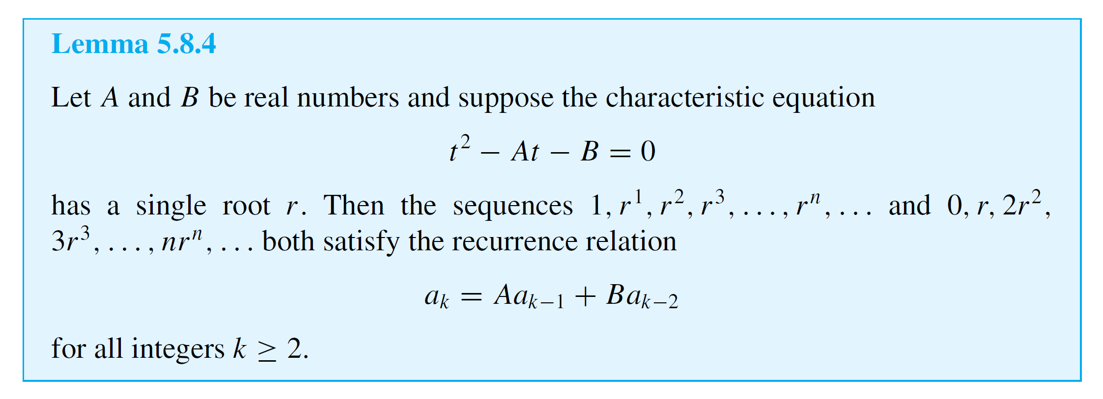
The Single-Root Case

Slide 32
The Single-Root Case
Lemmas 5.8.2 and 5.8.4 can be used to establish the single-root theorem, which tells how to find an explicit formula for any recursively defined sequence satisfying a second-order linear homogeneous recurrence relation with constant coefficients for which the characteristic equation has just one root.
Taken together, the distinct-roots and single-root theorems cover all second-order linear homogeneous recurrence relations with constant coefficients.

Slide 33
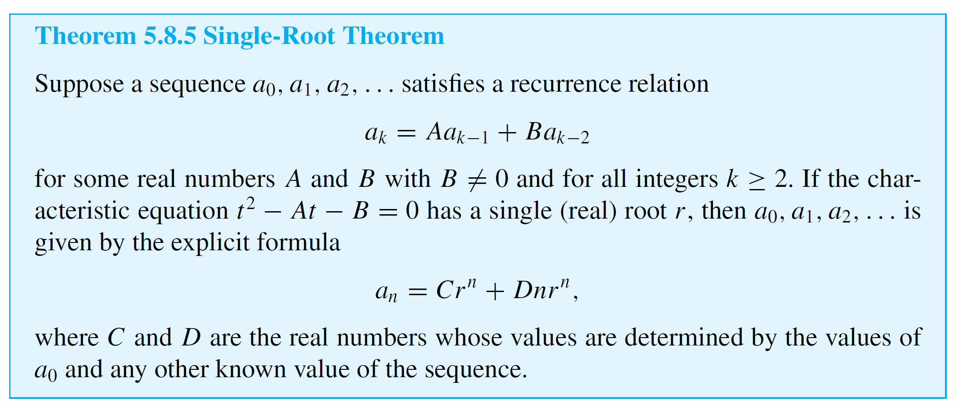
The Single-Root Case

Slide 34
Example 5 – Single-Root Case
Suppose a sequence b₀, b₁, b₂, . . . satisfies the recurrence relation
with initial conditions
b₀ = 1 and b₁ = 3.
Find an explicit formula for b₀, b₁, b₂, . . . .

Slide 35
Example 5 – Solution
This sequence satisfies part of the hypothesis of the single root theorem because it satisfies a second-order linear homogeneous recurrence relation with constant coefficients (A = 4 and B = –4).
The single-root condition is also met because the characteristic equation
t ² – 4t + 4 = 0
has the unique root r = 2 [since t² – 4t + 4 = (t – 2)²].

Slide 36

Example 5 – Solution
cont’d
It follows from the single-root theorem that b₀, b₁, b₂, . . . is given by the explicit formula
where C and D are the real numbers whose values are determined by the fact that b₀ = 1 and b₁ = 3.
To find C and D, write

Slide 37


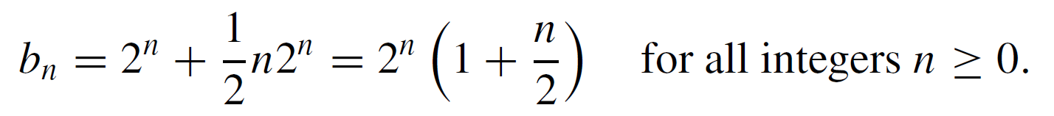
Example 5 – Solution
cont’d
Hence the problem is to find numbers C and D such that
C = 1
and 2C + 2D = 3.
Substitute C = 1 into the second equation to obtain
2 + 2D = 3,
Now substitute C = 1 and D = into formula (5.8.12) to conclude that

